Slide 1
IEEE Standards
Dr. S.L.JAYALAKSHMI,
VIT, Chennai

Slide 2
Outline
Wired
IEEE 802.3
IEEE 802.5
Dr. R.Radha, VIT Chennai

Slide 3
IEEE PROJECT 802
In 1985, the Computer Society of the IEEE started a project, called Project 802, to set standards to enable intercommunication among equipment from a variety of manufacturers.
Project 802 is a way of specifying functions of the physical layer and the data link layer of major LAN protocols

Slide 4
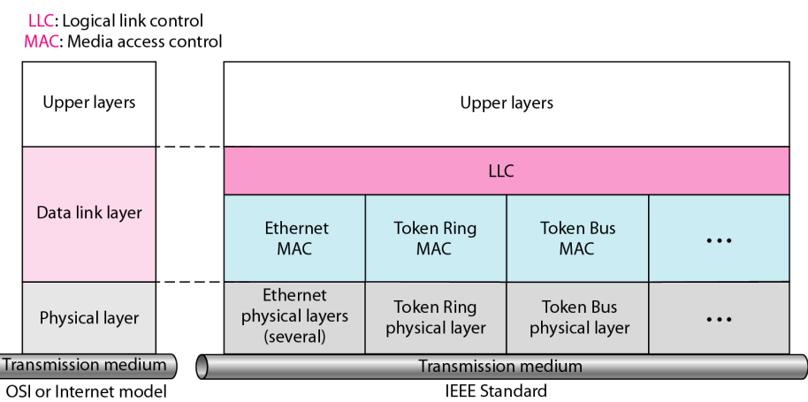
IEEE standard for LANs

Slide 5
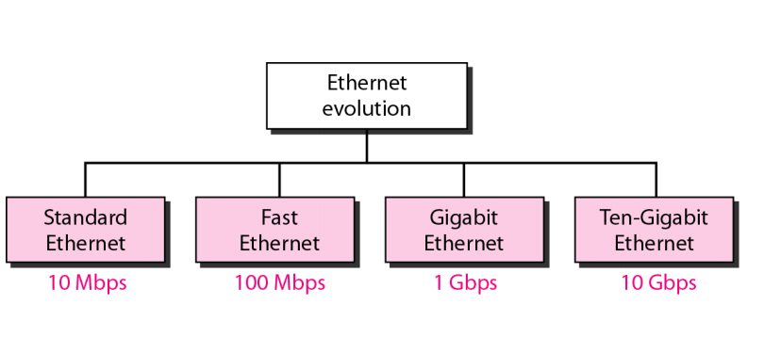
STANDARD ETHERNET
The original Ethernet was created in 1976 at Xerox’s Palo Alto Research Center (PARC). Since then, it has gone through four generations.

Slide 6
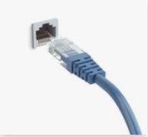
IEEE 802.3
Basics
Ethernet
Local area network
a common type of network cable used with wired networks
Computers connected through coaxial cables with total area of of 2.5 km
Ethernet cables connect devices such as PCs, routers, and switches within a local area network
Uses
CSMA/CD
Notes:
An Ethernet cable is a common type of network cable used with wired networks. Ethernet cables connect devices such as PCs, routers, and switches within a local area network. These physical cables are limited by length and durability. If a network cable is too long or of poor quality, it won't carry a good network signal. These limits are one reason there are different types of Ethernet cables that are optimized to perform certain tasks in specific situations.

Slide 7
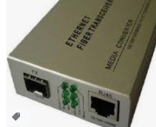
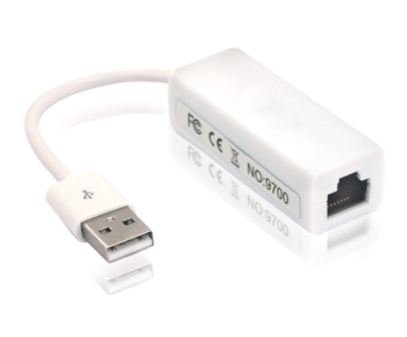
Transceiver & Adaptor
Ethernet Cable(Segment)
Transceiver Adaptor
Host
Source: Larry L Peterson & Bruce S Davie, “Computer Networks A Systems Approach”, 5 ^{th} Edition
Notes:
LAN adapters
www.amazon.com
Featured snippet from the web
Features : Give Your Laptop Or Desktop Computer More Connectivity With An Rj-45 (Aka Ethernet) Adapter. Simply Plug It Into Your Computer'S Usb Port And Hook Up! ... New Usb 2.0 To Lan Adapter/Usb 2.0 Ethernet 10/100 Network Lan Rj45 Adapter For Windows Os - Turn Your Usb 2.0 Port Into Lan Input!

Slide 8

Repeater
Repeater
Repeater Repeater
Hosts
Source: Larry L Peterson & Bruce S Davie, “Computer Networks A Systems Approach”, 5 ^{th} Edition

Slide 9
Types
10 Base5, 10Base2
10 Mbps
Baseband
Segment length ≤ 500m, 200 m
Hub
10BaseT
multi-way repeater

Slide 10
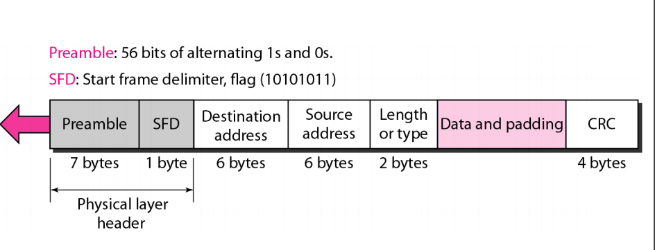
Medium Access Control Sublayer
Frame Format
Source: Larry L Peterson & Bruce S Davie, “Computer Networks A Systems Approach”, 5 ^{th} Edition

Slide 11
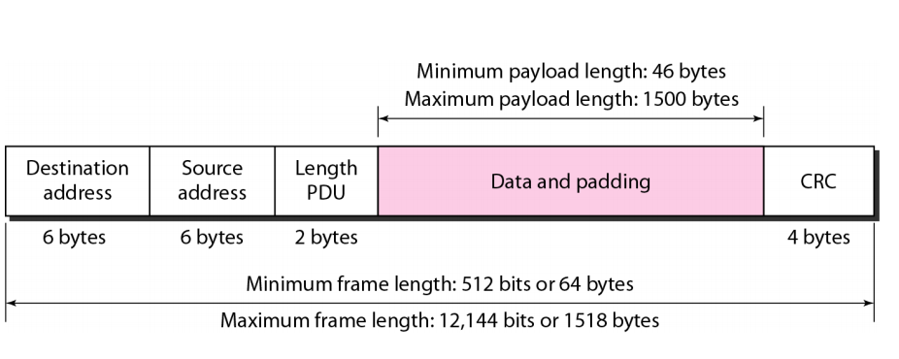
Frame Length
Frame Length:
Ethernet has imposed restrictions on both the minimum and maximum lengths of a frame.
Frame length: Minimum: 64 bytes (512 bits) Maximum: 1518 bytes (12,144 bits).

Slide 12
Frame format
Preamble. The first field of the 802.3 frame contains 7 bytes (56 bits) of alternating
Os and Is that alerts the receiving system to the coming frame and enables it to
synchronize its input timing. The pattern provides only an alert and a timing pulse.
The 56-bit pattern allows the stations to miss some bits at the beginning of the
frame. The preamble is actually added at the physical layer and is not (formally)
part of the frame.
Start frame delimiter (SFD). The second field (l byte: 10101011) signals the
beginning of the frame. The SFD warns the station or stations that this is the last
chance for synchronization. The last 2 bits is 11 and alerts the receiver that the next
field is the destination address.
Destination address (DA). The DA field is 6 bytes and contains the physical
address of the destination station or stations to receive the packet.
Source address (SA). The SA field is also 6 bytes and contains the physical
address of the sender of the packet
.

Slide 13
Frame format
Length or type. This field is defined as a type field or length field. The original
Ethernet used this field as the type field to define the upper-layer protocol using the
MAC frame. The IEEE standard used it as the length field to define the number of
bytes in the data field. Both uses are common today.
Data. This field carries data encapsulated from the upper-layer protocols. It is a
minimum of 46 and a maximum of 1500 bytes.
CRC. The last field contains error detection information, in this case a CRC-32

Slide 14

Addressing
Each station on an Ethernet network (such as a PC, workstation, or printer) has its own network interface card (NIC). The NIC fits inside the station and provides the station with a 6-byte physical address. the Ethernet address is 6 bytes (48 bits), normally written in hexadecimal notation, with a colon between the bytes.
Manufacturer-specific 24 bits prepended

Slide 15
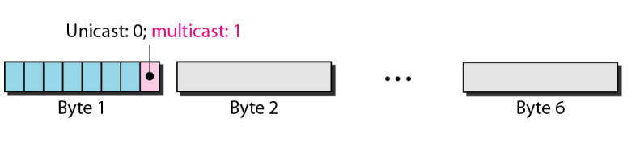
Unicast, Multicast, and Broadcast Addresses
Unicast, Multicast, and Broadcast Addresses.
A source address is always a unicast address-the frame comes from only one station.
The destination address, however, can be unicast(one-one), multicast(one-many), or broadcast(one-all).
Figure shows how to distinguish a unicast address from a multicast address. If the least significant bit of the first byte in a destination address is 0, the address is unicast; otherwise, it is multicast.
The broadcast address is a special case of the multicast address; the recipients are all the stations on the LAN. A broadcast destination address is forty-eight Is.
The broadcast destination address is a special case of the multicast address in which all bits are ones.
Notes:
A unicast destination address defines only one recipient; the relationship between
the sender and the receiver is one-to-one. A multicast destination address defines a group
of addresses; the relationship between the sender and the receivers is one-to-many.
The broadcast address is a special case of the multicast address; the recipients are
all the stations on the LAN. A broadcast destination address is forty-eight Is.
The broadcast destination address is a special case of
the multicast address in which all bits are Is.

Slide 16
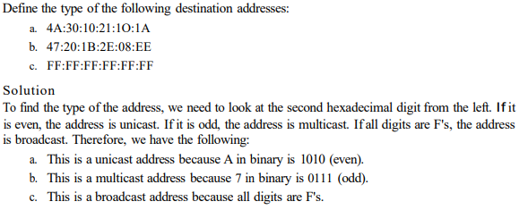
Example

Slide 17
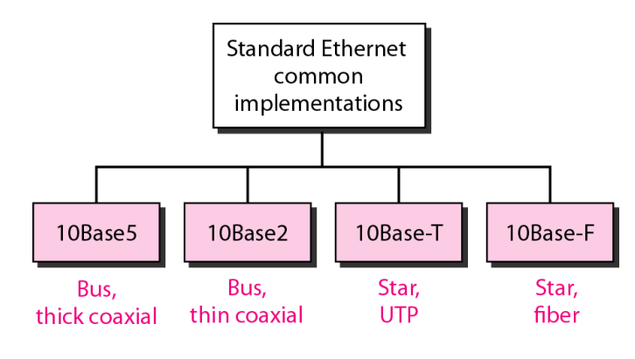
Categories of standard Ethernet

Slide 18
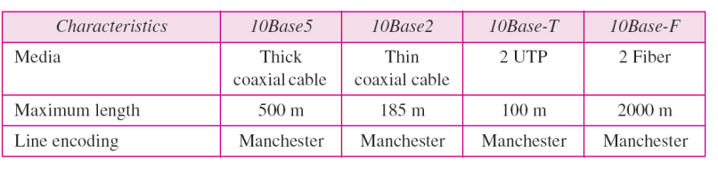
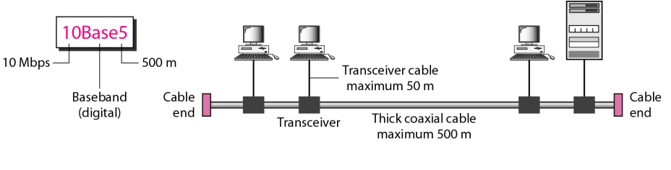
Implementation

Slide 19
Transmitter Algorithm
1.When adapter (host computer) contains frame to send and if line (channel) is idle, it transmits frame immediately.
2.The upper bound of 1500 bytes (maximum size of data or payload in Ethernet frame) within message means, that adapter can occupy line for fixed length of.
3.When adapter encompasses frame to send and if line (channel) is busy, it waits for line to go idle and transmits immediately.
4.Ethernet is claimed to be CSMA-1 persistent protocol because adapter with frame to send, transmits with probability 1, whenever busy line goes idle.
5.Since, Ethernet has no polarized/centralized control, it is possible for two (or more) Ethernet Adapters to start transmitting frames at identical time, either because both found path/line to be idle or both had been watching for busy line to become idle. Example – Let us assume that there are 2 host computers, connected to Ethernet cable. When both find line idle, they place their frames at identical time and this results in collision. Ethernet has no centralized control when frames hit one another, and this algorithm (Ethernet transmitter algorithm) will intimate host that collision has occurred. This is the reason, why Ethernet access method is named as CSMA/CD.
Notes:
sequence.Note – A preamble is used for bit synchronization, in E. 8 bytes of preamble and start of frame create pattern of 64 bits.
The reason why host computer needs to send 96 bits: host computer should send 32-bit jamming sequence to point collision went on and just 32 bits is insufficient. Hence, it must append 64-bit preamble.

Slide 20
6.When both Ethernet Adapters begin transmitting frames at a time, frames tend to collide on network.
7.Since, Ethernet supports collision detection each sender is in position to see that collision is in progress.
8.At the instant, when adapter detects that its frame is striking another frame, it makes it obvious to transmit 32-bit jamming sequence instantly (so that, other hosts know that collision has happened) and thus, host computer stops transmission presently.
Note – A Jamming sequence is signal sent by tool on Ethernet network to point that collision has occurred on network. The 32-bit length is required and, is long enough to traverse whole collision domain in order that all transmitting stations can detect collision).
9.Thus, transmitter will minimally send 96 bits just in case of collision. 64-bit preamble + 32-bit jamming

Slide 21
Runt Frame : We know that Ethernet will not create any frame that is less than minimum length of 64 bytes. It can be seen that runt frames are commonly caused by collisions. When 2 frames collide, it leads to collision, giving rise to “Runt frame”.
The other causes of runt frames are :
-Malfunctioning of network card / NIC card.
-Buffer under-run (It is state occurring when buffer is accustomed to communicating between two devices or processes is fed with data at slower speed than data/information that is being read from it).
-Duplex Mismatch (one side of line is running in half duplex mode & other side in fully duplex mode) / software issues.

Slide 22
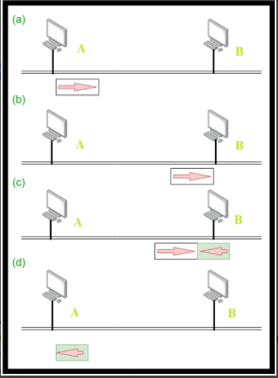
Ethernet Transmitter Algorithm – Worst Case Scenarios :
a)‘A’ (host computer) sends frame at time ‘t1’.
b)A’s frame arrives at ‘B’ (destination computer)
at time ‘t1+d1’. (‘d1’ : delay in transmission or propagation).
c)‘B’ begins transmitting at time ‘t1+d1’ and collides with A’s frame.
d)‘B’ runt frames (32 bit) arrives at A, at time ‘t1+2d1’.

Slide 23
Exponential Back-off (To avoid collision)
-Exponential Back-off is technique utilized by Ethernet to cut back probability of collision.
-Once Ethernet Adapter detect collision and stops, it’s transmission/conveyance, it waits for certain amount of time.
-After looking ahead to certain amount of time, Ethernet Adapter tries transmitting again. If Ethernet algorithm still finds channel busy, it doubles waiting time before trying again. If node waited for 1 second initially, it would then wait for 2 seconds, then 4 seconds, then 8 seconds, until channel goes idle.
-When channel is finally idle, Ethernet Adapter places frame in channel.
-This strategy of multiplying delay interval by two times between each re-conveyance attempt is ‘Exponential Back-off’.

Slide 24
Transmitter Algorithm
1-persistent protocol
Transmit if idle
Wait if not idle
Transmit once idle
Collision possible
Transmit 32 bit jamming sequence (totally 96 bits including preamble)
Notes:
The receiver side of the Ethernet protocol is simple; the real smarts are implemented at the sender‟s side. The transmitter algorithm is defined as follows: When the adaptor has a frame to send and the line is busy, it waits for the line to go idle and then transmits immediately.
Access Protocol for Ethernet :
Algorithm is usually called Ethernet Media Access Control (MAC) and is implemented in hardware on Ethernet Adapter (NIC).
Access method of Ethernet is CSMA/CD (Carrier-Sense Multiple Access with Collision Detection).
Encoding method is Manchester Encoding technique for converting data bits into signals.
The reason why Manchester Encoding technique is employed – Ethernet cable is connected through port, to Ethernet Adapter. So, application layer data is given to transport layer and is forwarded to network layer and then it comes to data link layer (where NIC card is present now).
So, frames that are created by host computer, need to be placed on Ethernet cable (on channel). When host computer, wants to place data/information on channel, we want to use some encoding technique.
Encoding is vital to convert particular data/frames, created by host computer, into signals because Ethernet cable For example, copper cable carries data in form of electric signals) will only carry signals.

Slide 25
Transmitter Algorithm (contd.)
To detect collision
Ethernet frame length ≥ 512 bits (14 bytes of header + 46 bytes of data + 4
bytes of CRC)
If collision detected
Exponential Back-off
Double delay interval for re-transmission

Slide 26
Fast Ethernet
Fast Ethernet was designed to compete with LAN
protocols such as Search Results
Web results Fiber Distributed Data Interface(FDDI) or Fiber Channel.
IEEE created Fast Ethernet under the name 802.3u. Fast
Ethernet is backward-compatible with Standard
Ethernet, but it can transmit data 10 times faster at a
rate of 100 Mbps.

Slide 27
IEEE 802.5
Basics
Token Rings
Useless if link or node fails
Notes:
Topology – Ring topology
Transmission – Unidirectional
Encoding – Differential Manchester encoding
Access control – Token passing
Data rates – 4 Mbps, 16 Mbps

Slide 28
Solution to Overcome Failure
Relay open: Host Included Relay closed: Host Bypassed
Source: Larry L Peterson & Bruce S Davie, “Computer Networks A Systems Approach”, 4 ^{th} Edition

Slide 29
Multi-station Access Unit (MSAU)
Combine relays, and fold
the logical ring into a
geometric star.
Source: Larry L Peterson & Bruce S Davie, “Computer Networks A Systems Approach”, 4 ^{th} Edition

Slide 30
Media Access Control
Network Adaptor has receiver & transmitter
If nothing to transmit, token circulates
To transmit data,
Sender picks token and transmits data
Every host checks if it’s the recipient
Copies if it is the recipient and transmit
Simply transmit, if not
Sender removes data and re-transmit token
http://www.cs.montana.edu/~halla/csci466/lectures/lec10-2.7-token.html
Notes:
Token Passing Concept
The token bit sequence circulates around the ring
Each node forwards the token (typically one bit at a time)
A note with data to send drains the token off the ring, and begins sending one or more frames
Each node forwards the frame(s) like any other bits
The destination node notices its address and saves a copy of the data as it passes by
When the sender sees its frame(s) return, it drains them off the ring and reinserts the token

Slide 31
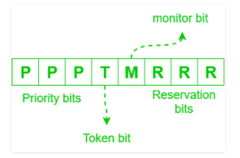

Frame Format
8 bits | 8 bits | 8 bits | 48 bits | 48 bits | Variable | 32 bits | 8 bits | 8 bits
Start Delimiter | Access Control | Frame Control | Destination Address | Source Address | Body | CRC | End Delimiter | Frame status
Frame control
Access control
Source: Larry L Peterson & Bruce S Davie, “Computer Networks A Systems Approach”, 4 ^{th} Edition
Notes:
Priority bits and reservation bits help in implementing priority. Priority bits = reservation bits = 3. Eg:- server is given priority = 7 and client is given priority = 0.
Token bit is used to indicate presence of token frame. If token bit = 1 –> token frame and if token bit = 0 –> not a token frame.
Monitor bit helps in solving orphan packet problem. It is covered by CRC as monitor are powerful machines which can recalculate CRC when modifying monitor bit. If monitor bit = 1 –> stamped by monitor and if monitor bit = 0 –> not yet stamped by monitor.
Frame control (FC) – First 2 bits indicates whether the frame contains data or control information. In control frames, this byte specifies the type of control information.

Slide 32
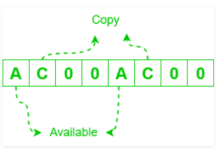
Frame format
Start/End delimiters use Manchester-violating symbols (steady high or steady low) that don't need escaping or stuffing
Access control and Frame control support miscellaneous protocol overhead
Addresses are 48 bits like Ethernet. They can be locally assigned or
universally assigned (which are set in harware and allocated like Ethernet
addresses). There are also Functional addresses for broadcast, or for
sending messages to hosts based on their function, like the Active Monitor
or Ring Parameter Server
CRC error detection
Frame Status byte allows the receiver to piggyback an ACK on the original frame
It makes use of 2 copies of AC bits are used as a
error detection mechanism (100% redundancy)
as CRC does not cover FS byte so that destination
does not have to recalculate CRC when modifying AC bits.
Notes:
Reliability
802.5 provides reliable delivery by piggybacking frame acknowledgement on the circulating frameFrame StatusThe last byte of a frame, even after the end delimiter, has A and C bitsInitiallySet by the sender to both 0At the DestinationSets A (address recognized) to 1 when it sees the frame is for it. Sets C (frame copied) to 1 if it copied the frame to its buffer correctlyBack at the SenderIf A is 0, the destination is not on this ring or is down. If A is 1 but C is 0, the destination is up but dropped the frame (perhaps its buffer is full, or the frame CRC failed) and the sender must retransmit

Slide 33
Issue and Solution
Token Holding Time (How long may a node hold on to the token while transmitting data?) is infinity.
3-bit priority
Host intending to send data, sets priority in the packet transmitted
Disadvantage: delay in transmission of low priority packets
Reliable transmission
2 bits: A and C initially set to 0
Receiver sets A on identifying it is the intended recipient, and sets C after copying
If both A and C are not set, retransmit
Notes:
There are 8 priority levels (a 3 bit number)
Both frames and the token have priority levels
A node may only take the token if it has a frame to send with equal or higher priority (than the token's priority)
A node with a higher-priority frame to send can set reservation bits in the header of a data frame as it goes by. When the data frame gets back to its sender, the sender will elevate the token to that priority and release it.
Multiple nodes may have made a reservation, for ever-higher priorities. And once the (now higher- priority) token is released any node with enough priority can take it.
But every node that made a reservation will lower the token to its pre-reservation priority when it releases the token. (It all works out.)
NOTE lower-priority data starves while there's higher-priority data on the ring
Reliability
802.5 provides reliable delivery by piggybacking frame acknowledgement on the circulating frameFrame StatusThe last byte of a frame, even after the end delimiter, has A and C bitsInitiallySet by the sender to both 0At the DestinationSets A (address recognized) to 1 when it sees the frame is for it. Sets C (frame copied) to 1 if it copied the frame to its buffer correctlyBack at the SenderIf A is 0, the destination is not on this ring or is down. If A is 1 but C is 0, the destination is up but dropped the frame (perhaps its buffer is full, or the frame CRC failed) and the sender must retransmit

Slide 34
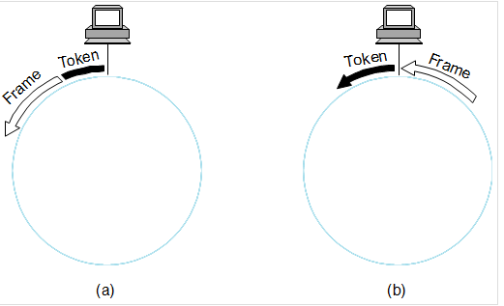
Early/Delayed Release of token
Does the sender put the token back on the ring after its last frame circulates and has been removed, or immediately after sending the last frame?
Delayed release is simpler and the earlier design, early release improves throughput
The difference is minimal on low-bandwidth, low-delay rings; significant on high-bandwidth, high-delay rings

Slide 35
Maintenance
Monitor
ensure non-loss of token
presence indicated periodically
For a host to become monitor,
Send claim token
If sender receives it back, then confirm
Else, highest address wins
Ensure presence of token by setting token rotation time(TRT)
≤ number of hosts * token holding time + ring latency
Notes:
A node has data to send. It takes the token off the ring and successfully transmits one frame before someone trips on its power cord. The MSAU preserves the ring connectivity, but that node was responsible for draining that frame back off the ring, and putting the token on. Now what?MonitorOne node on the ring has the job of monitorRoles of the MonitorBuffer the ring to ensure enough delay to hold a token
Restore a missing token: it knows the number of nodes on the ring and so calculates maxTRT. It keeps a timer of how long since it last saw the token pass by. If more than maxTRT, it injects a new token on the ring
Remove corrupted or orphaned frames: as a frame passes by it sets the "monitor" bit in the header. If it sees a frame with the bit already set, it drains it
Choosing a MonitorA new monitor is needed when the ring starts up, or when the existing monitor fails
A monitor periodically announces itself by circulating a particular control frame; if a node hasn't seen this frame within a certain time, it may assume the old monitor failed
When a node decides a new monitor is needed, it volunteers by circulating a claim token. If that token returns unchanged and it hasn't seen any other claim tokens, it "wins" and becomes the monitor
If two or more nodes transmit a claim token near the same time, they check the MAC address of all claim tokens passing by. The node with the highest MAC address wins

Slide 36
Maintenance (contd.)
Orphaned / Corrupted packet
Monitor bit – initially set as 0 by Sender
Set to 1 by Monitor
If passes through monitor again, packet drained
Dead Host
Beacon frame

